Slide 1
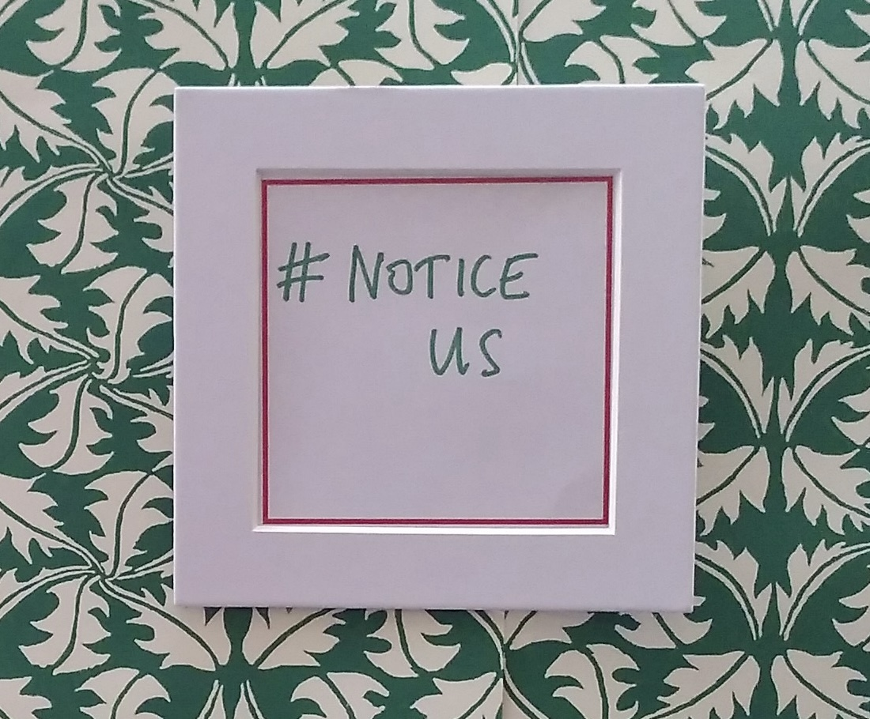
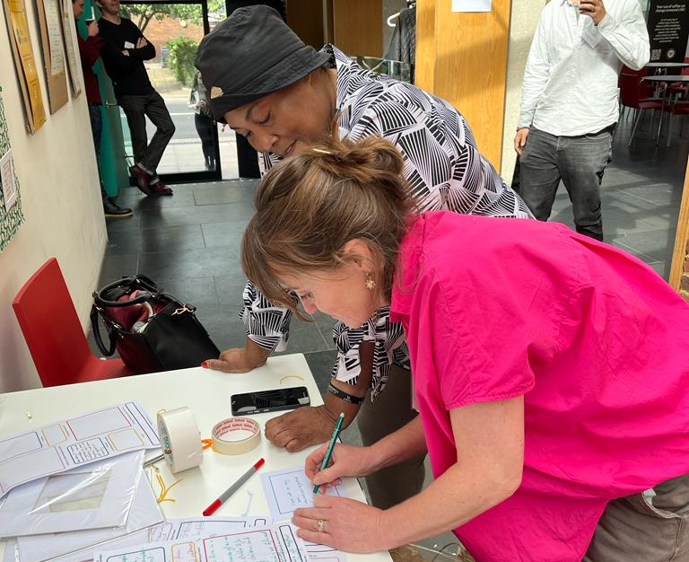
Better Temporary Accommodation for Londoners
September 2023 showcase
Summary of the event
Compiled by Leila Baker and Mary Carter
Better TA for Londoners Networking and Development Support Team

Slide 2
Contents
About the Better Temporary Accommodation for Londoners initiative
About the showcase
The Better TA for Londoners funded partners
Sessions held at the showcase
The new research
Partnership in action
Theme: Harms
Theme: Collaboration is key
Theme: Including the voices of lived experience
Calls to action
Find out more

Slide 3
Better Temporary Accommodation for Londoners
The Better Temporary Accommodation for Londoners initiative, funded by Trust for London and Oak Foundation, supports organisations to strengthen voice, connections and influence to improve people’s experience of temporary accommodation (TA).
A year on from the start of the programme, the funded partners held a one-day in-person event attended by around 70 people working to improve TA in London.
The September showcase celebrated the work of the Better TA for Londoners’ partners towards achieving the goal that stays in temporary accommodation should be as short, safe and healthy as possible.

Slide 4
About the Showcase
The Better TA for Londoners funded partners shared their insights and achievements about the work they’ve been carrying out through the initiative.
The day provided an opportunity to network with colleagues from communities and policymakers, both local to where they work, pan-London and nationally, united in wanting to see change.
Over the course of a day that was designed for solidarity, partners shared research insights and explored the challenges, barriers and opportunities to work collaboratively to tackle crisis levels of temporary accommodation use.

Slide 5
Better TA partners

Slide 6
Sessions held
Research findings - what it’s like to be in TA:
Groundswell, Positive East, London Gypsies and Travellers (LGT) and Central Hill Estate Residents Association (CHERA) all shared the results of new community-led research which was funded through the programme.
Partnership insights:
Justlife and Z2K provided insights into work with council colleagues in Westminster; and The Magpie Project discussed their work with Newham Public Health.

Slide 7
Sessions held
South West London Law Centres gave advance sight of a new self-assessment standards tool linked to regulations for people to use when they go into TA.
Shelter joined the partners to follow up on their recent report, Still Living in Limbo (March 2023) delving further into the TA experiences of, and impact on, young people.
Creating Ground, LGT and CHERA – showed powerful films they had made about the experience and insights of ‘temporary’ living.
The Magpie Project, Positive East, Creating Ground and GOSAD contributed to a vibrant exhibition space of posters and artwork.

Slide 8
The new research
All of the research is community-led and brings nuance and insight into the lived experience and longer term impact of stays in TA.
Groundswell launched their co-created research into people’s experiences of TA, health and homelessness.
London Gypsies and Travellers reported on their year-long project working with young people in Hackney.
Positive East’s project explored the specific needs and experiences of people living with HIV in TA.
Central Hill Estate Residents Association (CHERA) gave some interim findings from their work on an estate facing demolition where all residents are living temporarily and some are placed as TA residents.

Slide 9
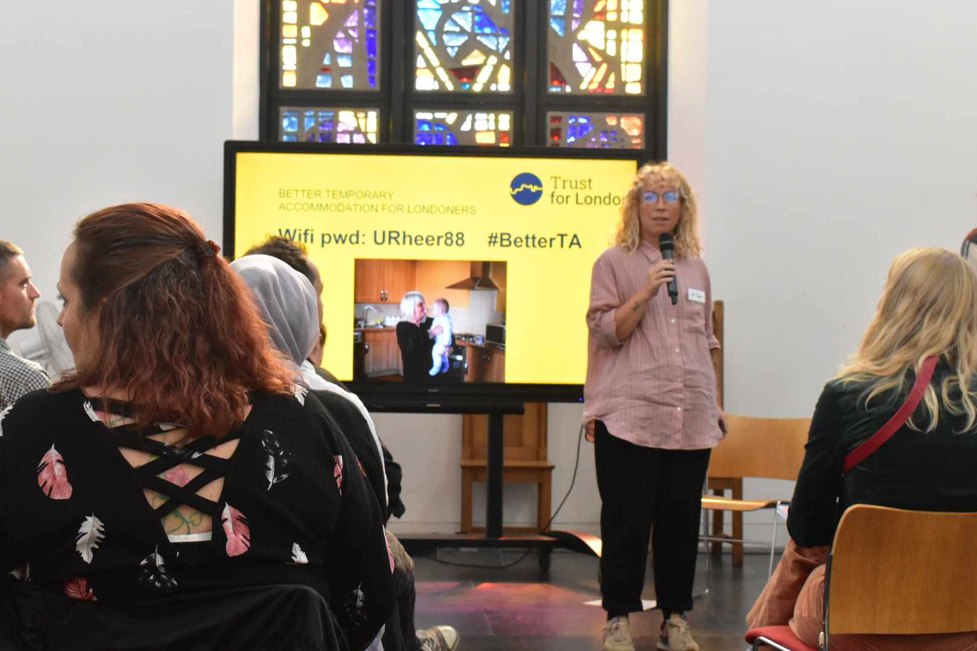
Partnership in action
﻿Z2K and Justlife talked about their work in Westminster, joined by a council housing colleague, to dig deeper into what it takes for local authorities and the voluntary/community sector to be able to work more closely.
The session was facilitated by Gill Taylor and Rebecca Towers who have been commissioned by Trust for London to conduct research on local authorities’ policies and practices in relation to TA and who’s report will be available soon.
The Magpie Project presented with a public health colleague from Newham describing how the alarm had been raised about issues faced by people living in emergency and Home Office Contingency Hotels; and how public health were both open to hearing and active in developing solutions.

Slide 10
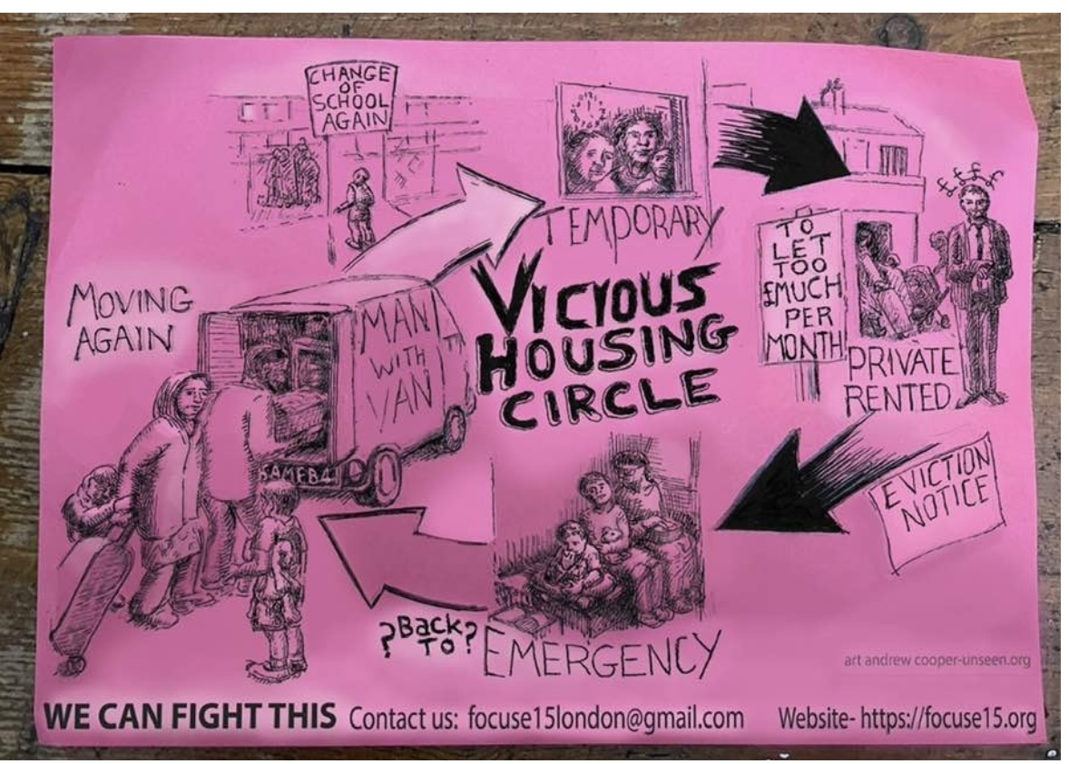
Theme: Harms
The showcase reiterated some of the damages caused by stays in TA that are now widely acknowledged:
TA has a detrimental impact on people’s physical health due to poor standards and a lack of repairs (including around damp and mould) as well as electrical safety and lack of storage.
It directly increases anxiety and mental health problems through e.g. living in unsafe conditions, traumatic incidents, the stigma attached to TA as well as other forms of discrimination, and the impact of feelings of powerlessness and isolation.
It interrupts education (long journeys to maintain pre-TA schooling and lack of space to study) and damages the life chances of young people.
It adds to basic living costs and essentials such as cooking, laundry and internet access (essential for benefit and housing claims) are often more expensive.
It contributes to poor levels of trust and engagement with authorities, with experiences of discrimination and unequal treatment, short-notice relocations and dislocation from social/family networks exacerbating poor relations.
Credit: Focus E15/andrewcooper-unseen.org

Slide 11
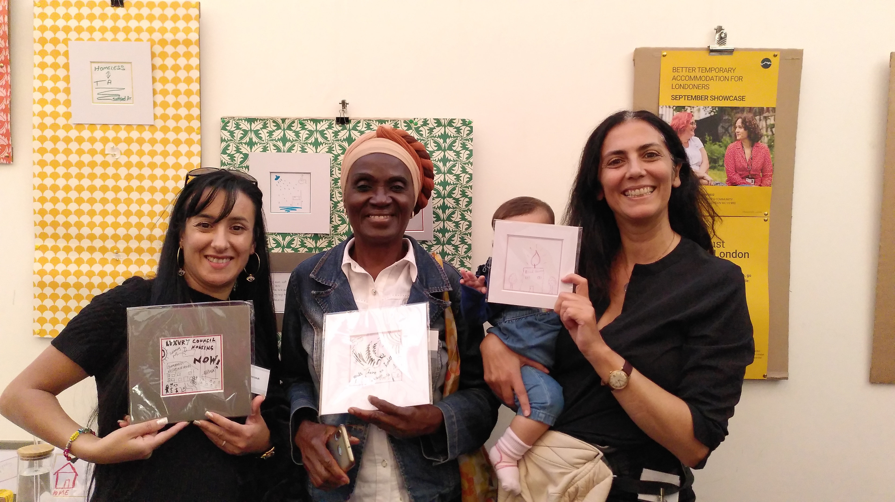
Theme: Collaboration is key
﻿People in TA, the agencies that support them and local government officers operating the system, recognise TA as the result of broken housing and welfare systems.
No one actor has control over solutions – we all have a part to play.
Spaces where all the stakeholders get together, including people with lived experience of TA, such as those being developed by Justlife’s TA Action Groups (TAAGs), can create a positive environment for honest conversations which understand each other's positions and create actions for change.
There are plenty of constraints to local authority action – finances, boundaries and in meeting statutory requirements to find properties – but plenty of examples of where partnerships make a difference, such as Creating Ground’s work with Greenwich around digital inclusion; and The Magpie Project’s work with public health, that improved referral pathways and added to what was available around play spaces and cooking facilities.
There’s lots of learning about what it takes to build relationships that can bring about change – understanding they take time, require a rebalancing of power in how they function, can focus on smaller changes as a way to build trust, and, very importantly, benefit from including people with lived experience.
Collaboration works well when local authorities value the voluntary sector’s role in advocacy, and don’t require the sector to agree on everything. Also when the collaboration is focusing on areas of common interest.

Slide 12
Theme: Including the voices of lived experience
The showcase benefitted hugely from hearing from people with lived experience who were part of the sessions, films and artwork.
We heard about the importance of:
bringing people with lived experience into policy and practice discussions – their personal insights can hold authorities to account, speak to what is happening in reality; and identify and contribute to, the smaller changes that authorities can make to mitigate the impacts of broken systems.
solidarity when people are up against such difficult circumstances and living conditions; the strength of friendships that can emerge when people come together; and the change that can happen as a result of it.
adopting sensitive approaches to including people with lived experience: understanding and balancing power relationships; that conversations are personal and immediate to people in TA and they will want to improve their current situation as well as contribute to future change.
recognising and valuing the contributions of people with lived experience. They are often the only people in the room who aren’t paid and they should be recompensed.

Slide 13
Calls to action (these are direct quotes from people who took part in the day’s presentations and discussions)
We need to stop letting people get away with calling it temporary accommodation.
It is anything but temporary and the use of the term is damaging and creates uncertainty.
Invest in more housing – home is everything, home is a human right, home is the future of people.
Improve temporary accommodation housing conditions.
Be both passionate and professional – you don’t need to pick one.
We need to nurture the full ecology of change – grassroots to government.

Slide 14
The future is now, making changes, changing minds.
(quotation taken from artwork created on the day)

Slide 15
Find out more about the Better TA for Londoners initiative at trustforlondon.org.uk/what-we-do/housing/temporary-accommodation/
For more information about the initiative’s current work, contact
Susie Dye susie@trustforlondon.org.uk

