Slide 1
Local authority management of the private rented sector
Dr Julie Rugg, Centre for Housing Policy
University of York

Slide 2
Structure
The private rented as a housing system
PRS problems from the local perspective
Obstacles to effective local authority management
Framing a strategic approach

Slide 3
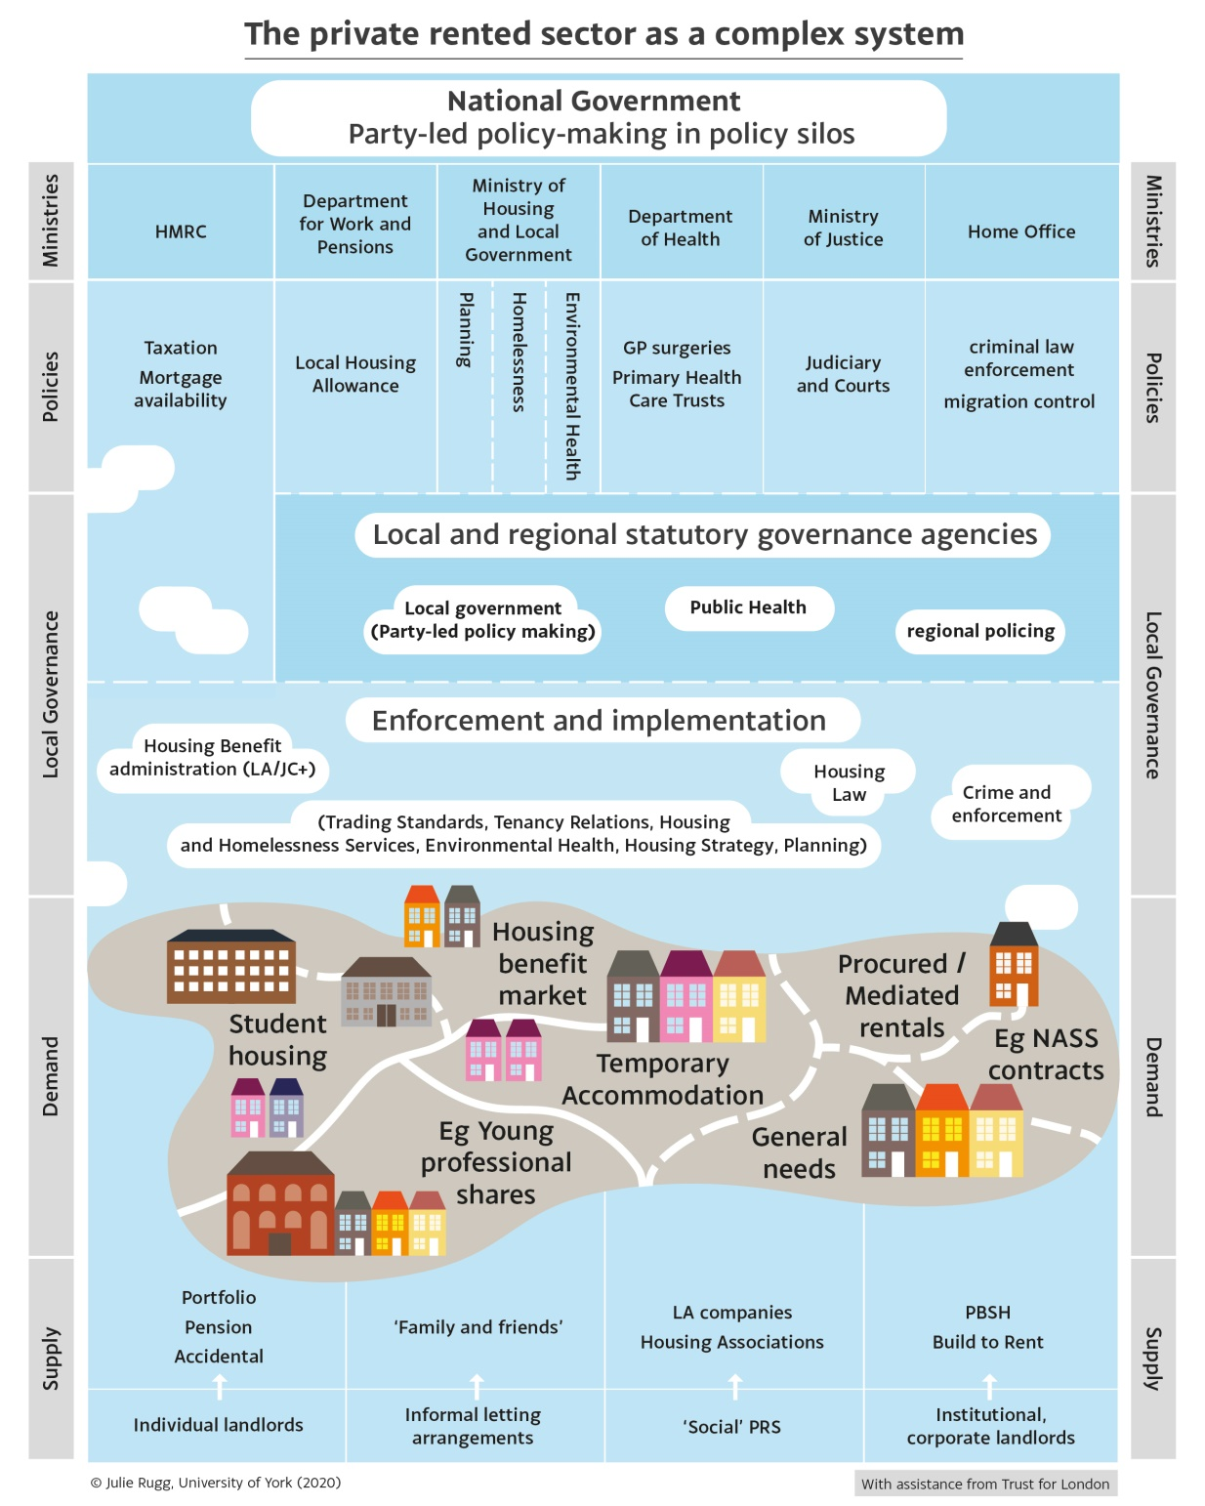
The PRS as a housing system

Slide 4
PRS problems from London borough perspectives
Substantial growth that is not necessarily well understood at a local level
Rapid growth of submarkets eg short-term lettings
A ‘wild west’ sector that feels entirely unmanageable: proliferation of types and incidence of illegal practices
Affordability and supply issues increasing the incidence of homelessness
Competition within and between local authority procurement services
Uneven enforcement creating pockets of ‘opportunity’
‘Late-starter’ local authorities with limited history of working on/with the PRS very much on the back foot

Slide 5
Obstacles to effective local authority management
Political will
Intelligence sharing
Depletion of resources, skills and local knowledge
Retaining momentum
Legislative confusion

Slide 6
Framing a strategic approach
Defining broad objectives for intervention
Auditing existing intelligence: ‘know what you know’
Auditing service interventions: ‘know what you do’
Auditing enforcement powers
Assessing the strategic shortfall: where are the gaps? Who should be in the room?

