Slide 1


Professor Loretta Lees, Chair
Presentation to Homes for Londoners Board, Tuesday 14 December 2021

Slide 2

London Housing Panel: our diverse membership
More at: https://bit.ly/LHPanel
*One person with lived experience of disability attends in a personal capacity as a guest of the Panel

Slide 3
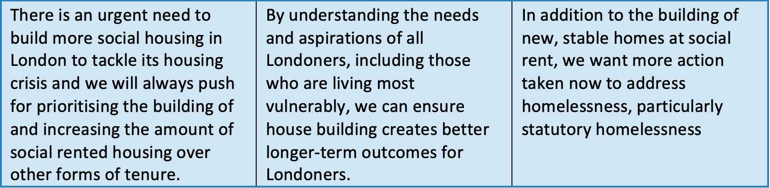
London Housing Panel’s three principles

Slide 4

London Housing Panel Priorities agreed with the Mayor
#1. Massively increase social housing supply
#2. Support all Londoners to be heard and thrive
#3. Take action on temporary accommodation

Slide 5
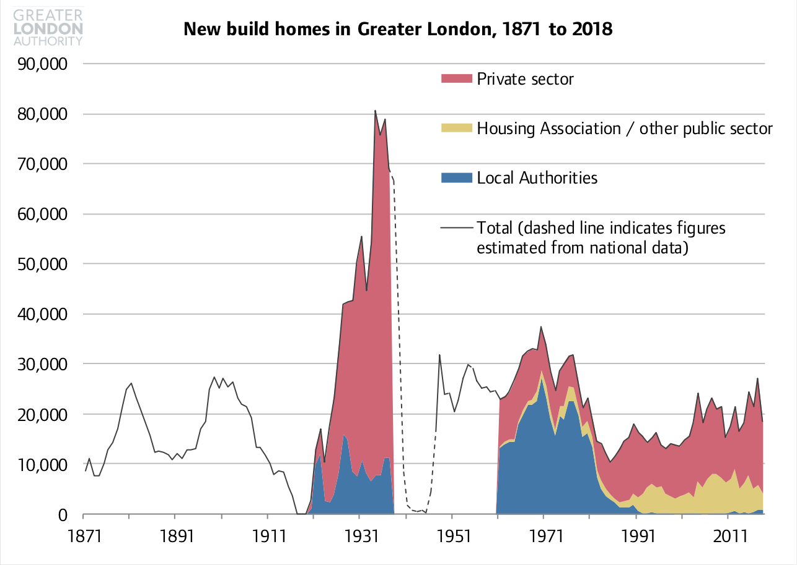
#1: Massively increase social housing supply
Positive indicators:
The re-introduction of self-financing and the Mayor's Building Council Homes for Londoners programme which have enabled councils to ramp up supply again.
3,150 new council home starts recorded in 2020/21 by the GLA, only slightly lower than the 3,300 starts recorded in 2019/20, and the second highest figure since the 1982/83 peak.
But it is early days and the LHP is here to do some creative thinking on this.

Slide 6
#2: Support all Londoners to be heard and thrive
Worked on VOICE through embedding relationships with communities for the long term and ways of working that are inclusive of the people who need to be included.
Equality, Diversity and Inclusion (EDI) Action Plans are now part of the implementation of the Affordable Homes Programme: monitoring progress and informing future development.
Improved and more meaningful Equalities Impact Assessment (EqIA) statements are now required in housing delivery reports to Homes for Londoners, as a way to improve the way equalities are addressed at every stage of decision-making about housing delivery.

Slide 7

#3: Temporary Accommodation
March 2021 >60,000 homeless households in TA (incl. 84,310 children). Households in B&Bs increased by 17% 2020-21.
A TA roundtable and new three-way collaboration with the LHDG was instigated by the LHP and is now in place.
Work with London Councils
The TA roundtable identified five strands of work:
Prevention
Advice
Quality of life
Enforcing standards
Making best use of stock

Slide 8
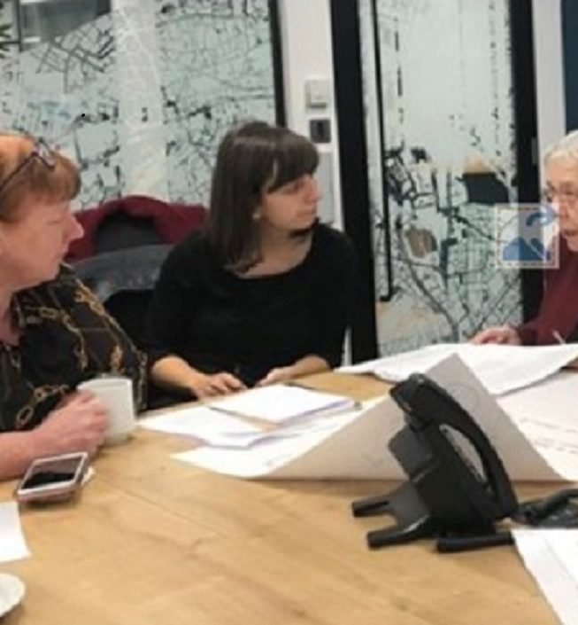
A successful year of collaborative working
(the value of co-production)
We
provided early stage feedback on the eight Recovery Missions identified by the Board;
started a reciprocal programme of observing meetings;
brokered a programme of bilateral conversations between members and officers;
are convening a learning event in Spring 2022; and
working on the need to improve community access to housing data
Notes:
1.

Slide 9
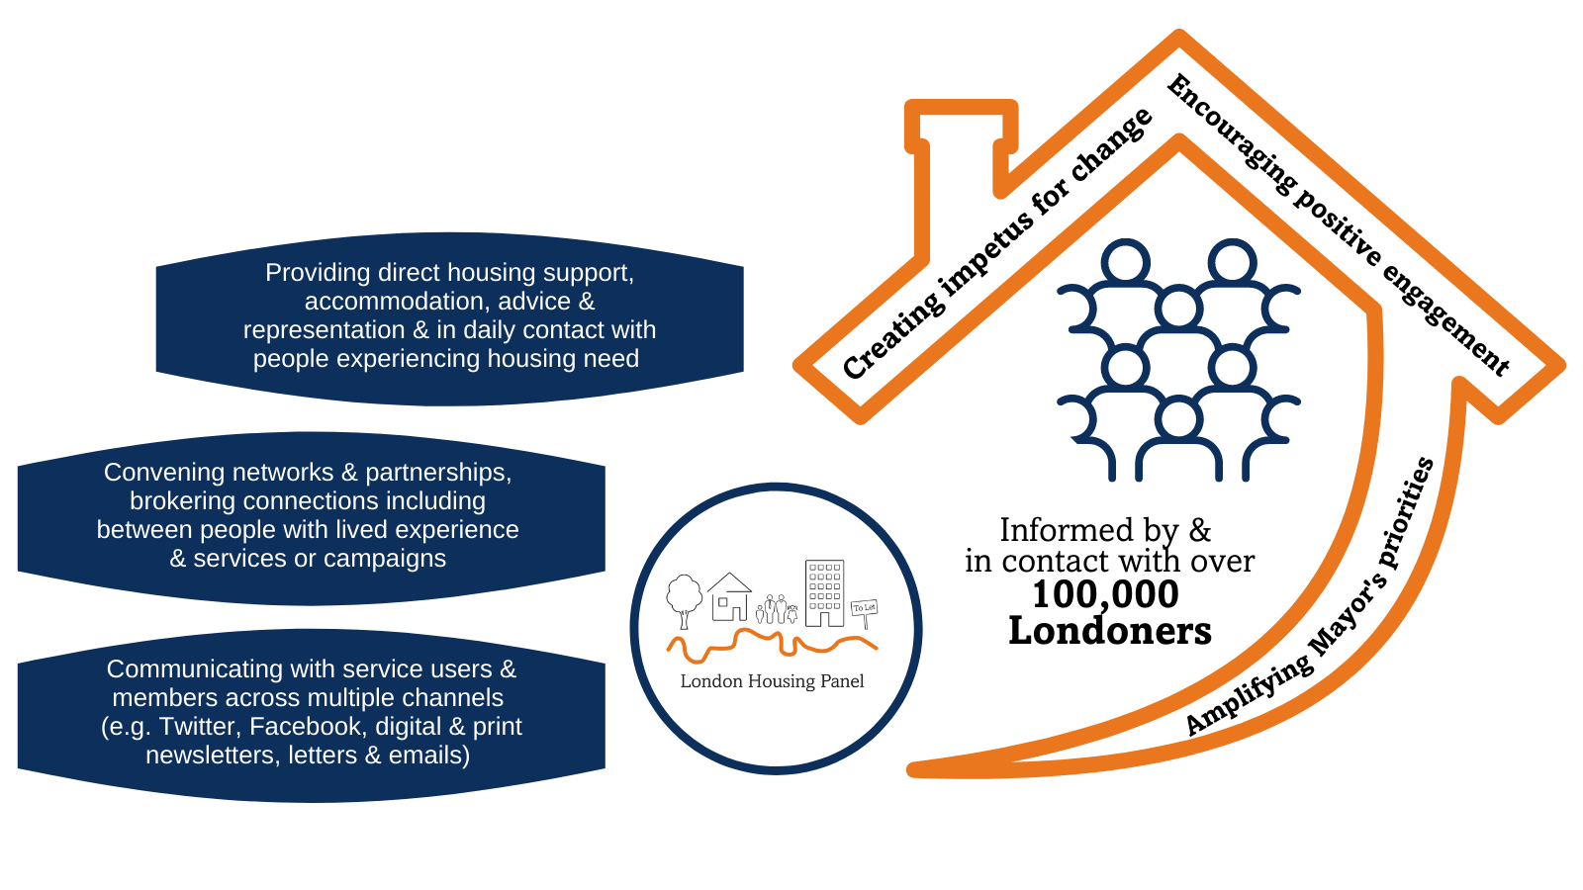
London Housing Panel’s reach and value

